Slide 1
Cyber Disaster Risk Reduction
A Session
On
Necessity Of Cyber Drill
To
Assess, Identify and Mitigate
Threats

Slide 2
Some basic questions…
What is disaster ?
What is cyber disaster ?
Panic !!!
What is risk ?
What is control ?
What is drill ?
What is Assessment ?
What is Identification ?
What is Mitigation ?

Slide 3
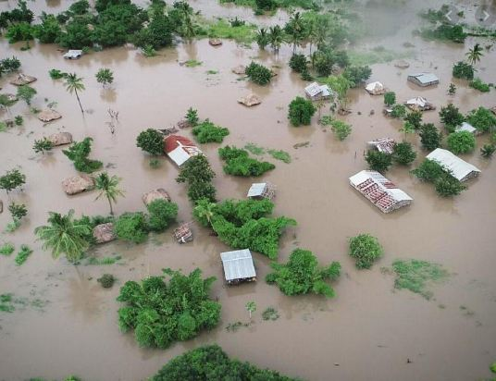
Natural Disaster…

Slide 4
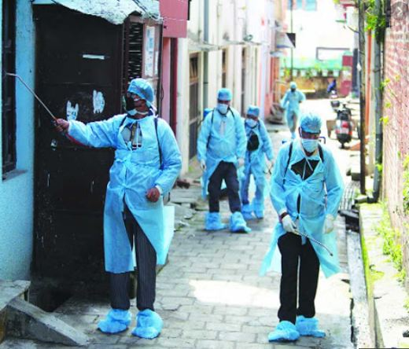
Virus Outbreak…

Slide 5
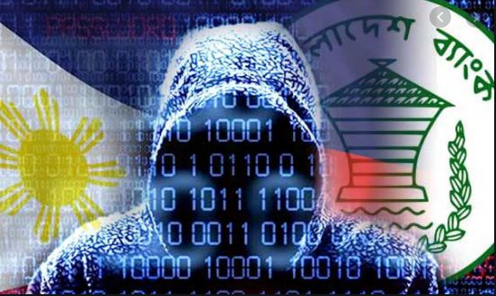
Cyber Disaster… is it ?

Slide 6

Lock… do we need it ?

Slide 7
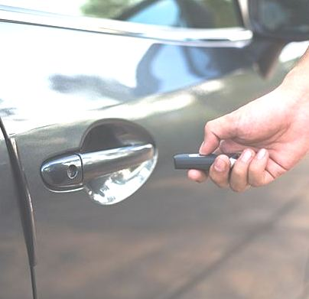
Car Lock… is it required ?

Slide 8

Drill ??

Slide 9

Some Basic Drills…easy to do
Back Up Restoration
Critical Device Failover
(Gateway, Core Switch, UPS, etc.)
Firewall Rule / Policies
End Point and Email DLP
Phishing Email
Access Rights Reconciliation

Slide 10

Is ‘drill’ necessary for an experts ?

Slide 11
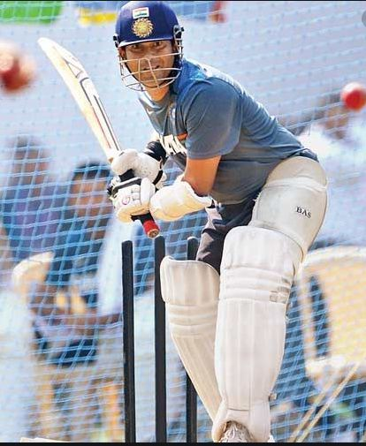
Net Practice… Sachin ??? He is GOD !

Slide 12
Case 1:
A ‘Business Development Manager’ deployed abroad was preparing a business case for a prospective client and needed some client data from his own team working with a different client in the same industry sector. Anticipating existence of content filtering device / solution in client’s network, he advised the team member to copy the data onto his pen drive and send the same by email from his home using his private email. The data leak prevention tool deployed at the end-point generated alert in customer’s network when he tried to copy the data to pen drive. This activity created embarrassment for the service providing company with potential impact on current and future business opportunities.

Slide 13

Assess ……what has happened

Slide 14

Identify……the root cause

Slide 15
Mitigate……by planned treatment

Slide 16
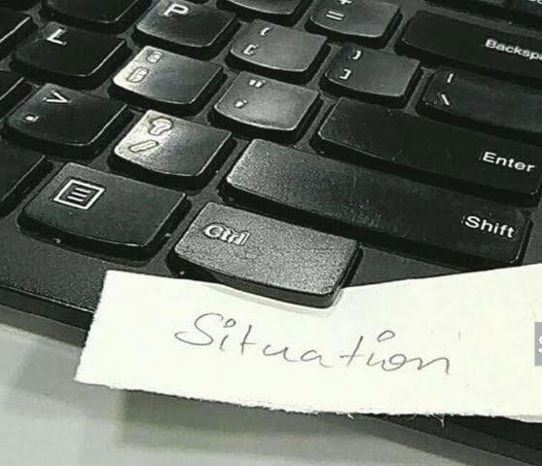
AIM ?
&…..Avoid Recurrence

Slide 17
Case 2
“An employee was working on a project and had to give a presentation to the prospective client. In order to make the presentation quite impressive, she wanted to use specialized tool. As procurement of this tool would have taken long time, she searched internet for alternative free software (freeware) with similar feature. She downloaded the freeware on her computer. After installing the software, she felt that her computer had slowed down. She reported the matter to her IT support team which found that a malware had dropped in, probably with the freeware that she had downloaded.”
Case 3
“The Engineer who was responsible for the bank’s IT systems, had attended performance appraisal meeting with his supervisor. It hadn’t gone well. He was quite upset and was ready for a revenge. With mind full of revenge and all administrative privileges, in the evening, he knowingly transmitted a code and command to 10 routers of bank’s “Control Center” and by transmitting that code, erased the running configuration files in nine of the routers, resulting in a loss of connectivity to approximately 90 percent of bank’s network across the country.”

Slide 18
Quiz !!!
‘CORONA Virus’ panic may cause cyber incident !!!
TRUE
FALSE

Slide 19

Part

Slide 20
Case -3
Panjab And Maharastra Cooperative Bank Scam
November 2019
Case -4
Panjab National Bank Scam
January 2018

Slide 21

Tathagata Datta | 9830089446 Director Cyber Security | Praxis Business School
Namaskar
from
A Learner

