Slide 1




On the Job Training (OJT) Basic Level on Cyber Security for Government Employees
Organised by
Cyber Security Centre of Excellence (CS-CoE),
Department of Information Technology & Electronics,
Government of West Bengal
2019-2020
Event Partner

Slide 2

What is Cyber Security?
Presentation by:
Cyber Security Centre of Excellence (CS-CoE)
Department of Information Technology & Electronics, Government of West Bengal

Slide 3
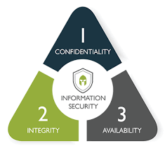
Cyber Security
Cybersecurity is the practice of protecting systems, devices, networks and programs from digital attack(s).
The purpose of cybersecurity is to help prevent cyberattacks, data breaches and identity theft and aid in risk management.
When an organization has a strong sense of network security and an effective incident response plan, it is better able to prevent and mitigate cyber-attacks

Slide 4
Cyber Security
Infrastructure Security
Application Security
Data Security
Internet of Things Security
Vulnerability Management
Identity & Access Management
Governance , Risk and Compliance
What is VULNERABILITY - weakness which can be exploited

Slide 5
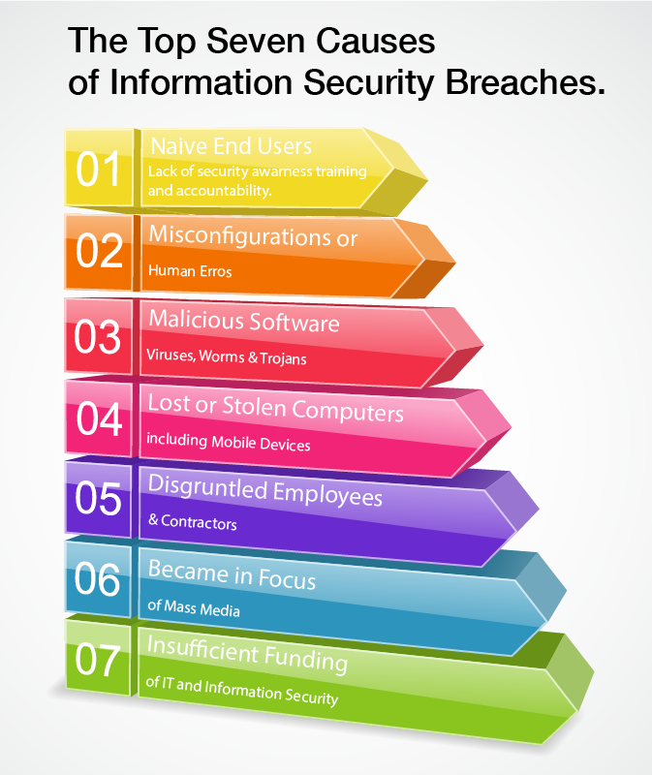
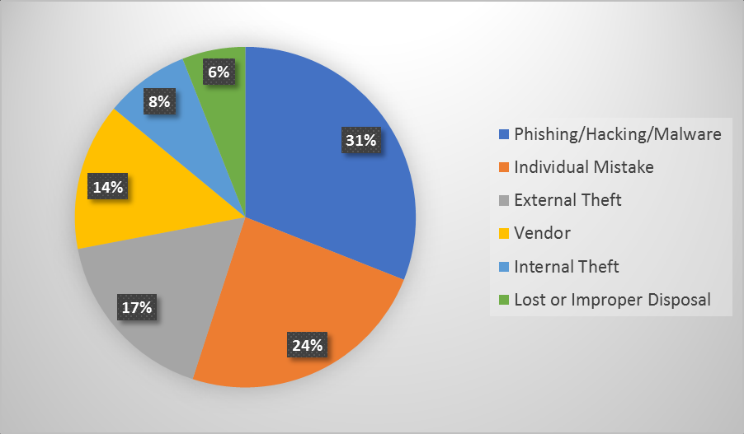
Top causes of Security Breach
Source : Computer Forensics

Slide 6
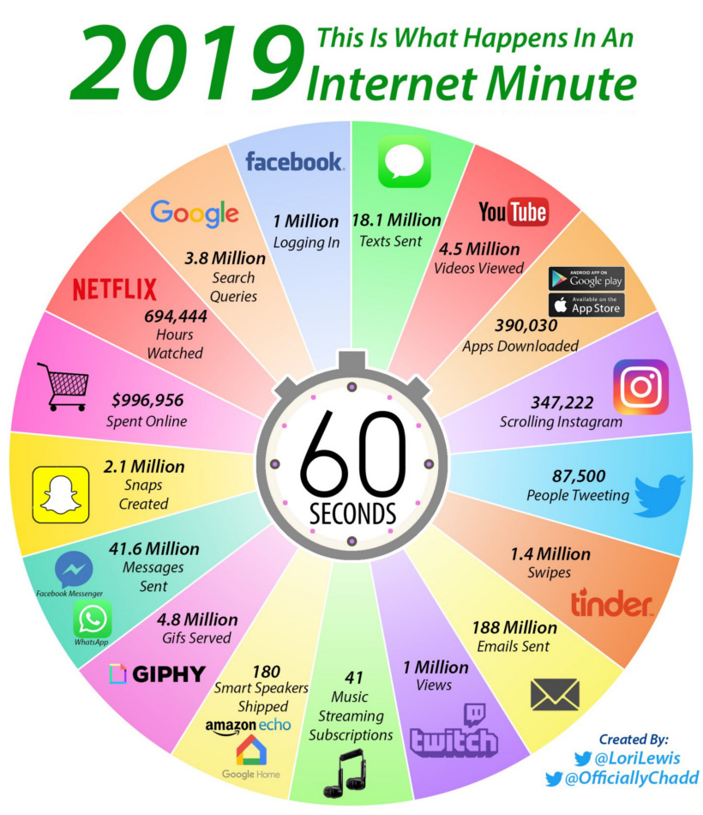
Minute on the Internet in 2019!
Reference:
Desjardins, J. (2019). What Happens in an Internet Minute in 2019?. [online] Visual Capitalist. Available at: https://www.visualcapitalist.com/what-happens-in-an-internet-minute-in-2019/

Slide 7
Identity Theft
Identity Theft:
The fraudulent practice of using another person's name and / or personal information without their consent for personal gains.
Examples of Identity Theft:
Fake Facebook / Twitter / Social Media profile
Accessing financial applications / website
Relevant Sections:
Section 66- C of Information Technology Act (as amended till date)
Section 419 of Indian Penal Code 1860 (IPC)

Slide 8
Modus Operandi for Identity Theft
Shoulder surfing
Collecting personal data by Phishing / Spam / Spoofing
Vishing
Purchase of personal information.
Collecting information from open WiFi / Unsecured networks.
Using Malwares
Data breach
Financial Frauds - Skimming of cards / Phishing etc.

Slide 9
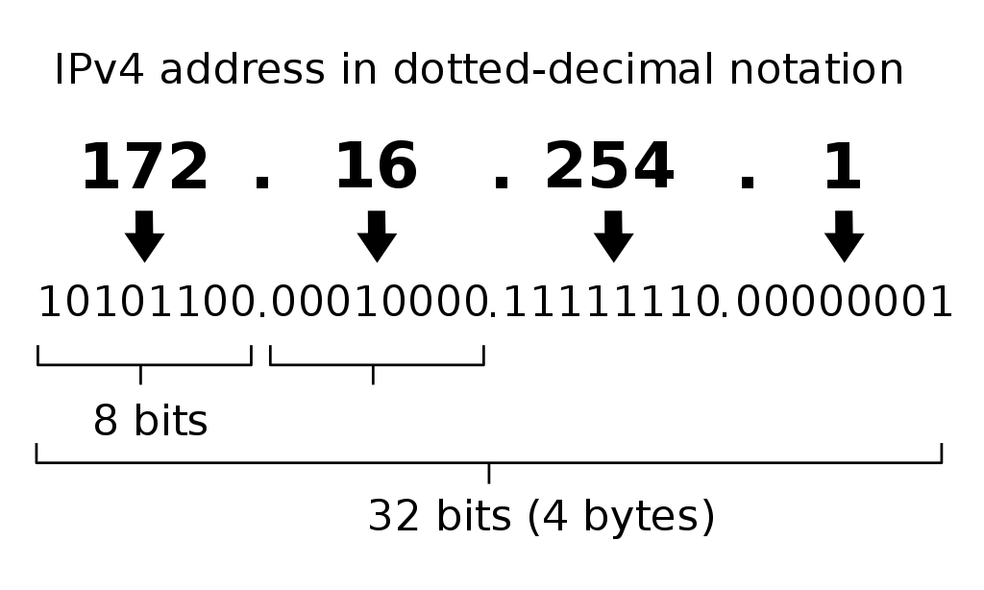
IP Address
Numerical label assigned to each device connected to a computer network.
IPv4 addresses and IPv6 addresses – 32 and 128 bits
How to find IP Address – Computer , Cell Phone
Static and Dynamic IP Address
Public and Private IP Address

Slide 10
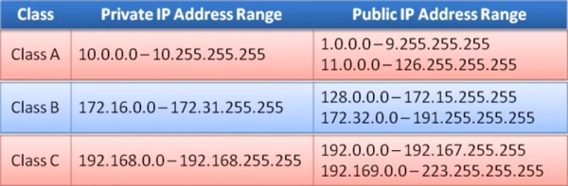
IP Address

Slide 11
IMEI Number
An IMEI number is a globally unique 15 digit number assigned to all cellular devices, which identifies your device within the mobile network. We can use this number to block a mobile phone from being used by another person or phone company if it has been lost or stolen.
Dial *#06#

Slide 12
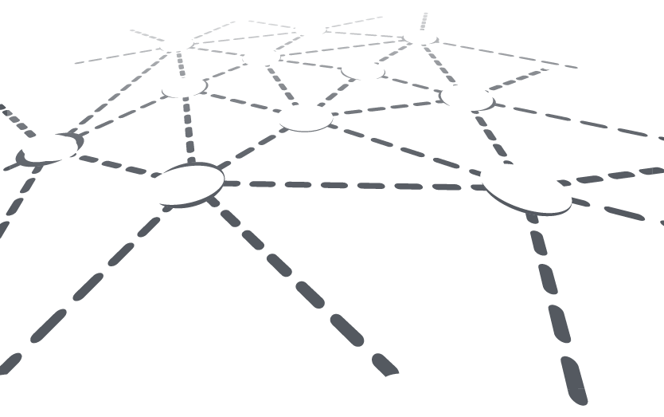




































Thank you

