Slide 1


Cyber Security Centre of Excellence
Department of Information Technology & Electronics, Government of West Bengal
https://cscoe.itewb.gov.in

Slide 2
Operating Systems
Security flaws and how to patch
Promathesh Mandal, CS-CoE West Bengal
Palash Kumar Dutta, CS-CoE West Bengal

Slide 3
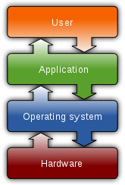
Operating system
An operating system (OS) is a system software that manages computer hardware, software resources, and provides common services for computer programs.
An Operating System (OS) is an interface between a computer user and computer hardware.

Slide 4
Types of Operating system
Batch Operating System
Multitasking/Time Sharing OS - Unix.
Multiprocessing OS - LOCUS.
Real Time OS – Used for embedded systems.
Distributed OS.
Network OS - Windows Server, Linux, etc.
Mobile OS.

Slide 5
How to Secure your PC after a Fresh Windows Installation
Keep your Windows operating system up to date
Update your software
Create a restore point
Back up your system
Use a standard user account
Enable the User Account Control (UAC)
Use an encryption software tool for your hard drive - Bitlocker

Slide 6
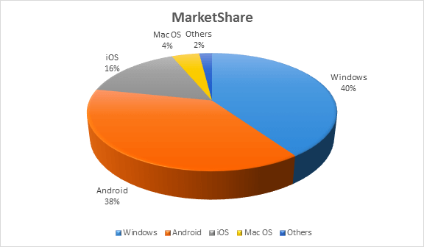
list of Operating Systems
OS Name | % of Market Share
Windows | 40.34
Android | 37.95
iOS | 15.44
Mac OS | 4.34
Linux | 0.95
Chrome OS | 0.14
Windows Phone OS | 0.06

Slide 7
Windows 10 Security Flaws
SMB v1 vulnerability could allow a remote attacker to take control of an affected system
Remote Desktop Services Remote Code Execution Vulnerability (CVE-2019-0708)

Slide 8
Disable SMB on Windows 8.1 And Windows 10: Powershell Method (as administrator)
To check whether SMB v1 Protocol is active on your machine
Get-WindowsOptionalFeature -Online -FeatureName SMB1Protocol
To disable SMB v1 Protocol on your machine
Disable-WindowsOptionalFeature -Online -FeatureName SMB1Protocol
To check and disable SMB v2/v3 Protocol
To check— Get-SmbServerConfiguration | Select EnableSMB2Protocol
To disable— Set-SmbServerConfiguration -EnableSMB2Protocol $false

Slide 9
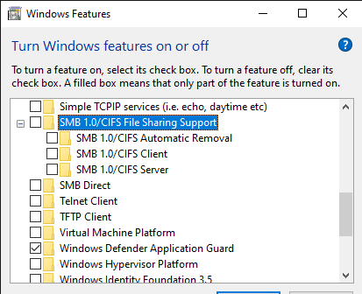
Disabling SMB On Windows 8.1 And Windows 10: Windows Features Method
Go to the “Control Panel”
Select “Programs”
Select “Programs and Features”
Click on “Turn Windows features on or off” on the left panel
“Windows features” window will appear
Scroll down and uncheck both “SMB 1.0/CIFS File Sharing Support” & “SMB Direct”
Click “Ok”

Slide 10
Disabling Remote Access in Windows 10
Steps to Disable Remote Access in Windows 10
Type “remote desktop settings” in the “Cortana search box”. Select “Allow remote access to your computer”. This may seem counter-intuitive, but this opens the Control panel dialog for Remote System Properties.
Check “Don’t Allow Remote Connections” to this Computer. You've now disabled remote access to your computer.

Slide 11
How to identify, prevent and remove rootkits in Windows 10
Rootkits are among the most difficult malware to be detected and removed. Now, new variations are targeting Windows 10 systems. Use following advice to protect yourself from them.

Slide 12
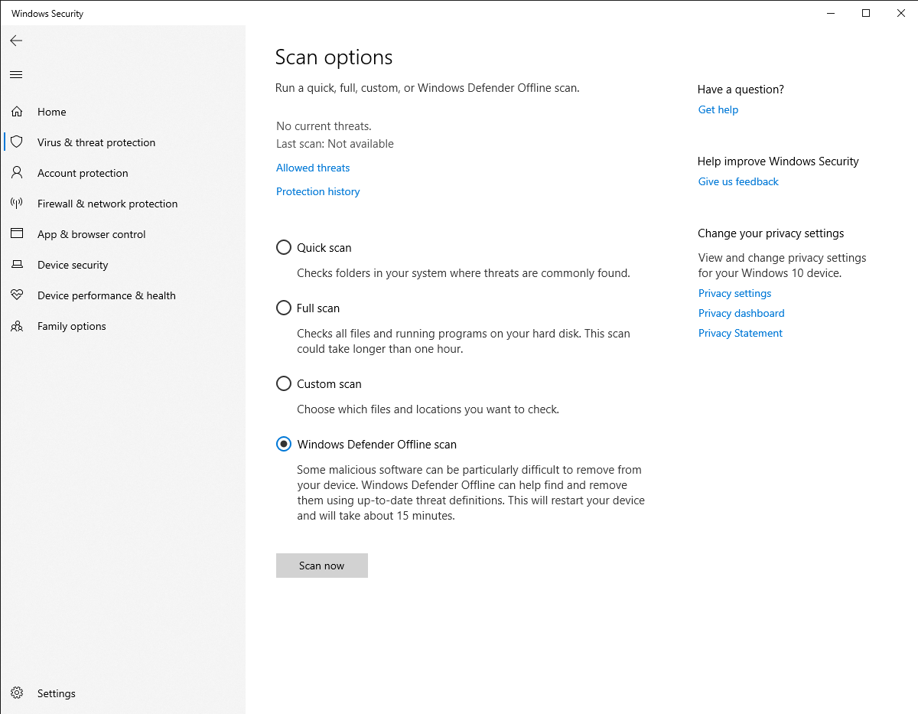
How to remove rootkit malware

Slide 13
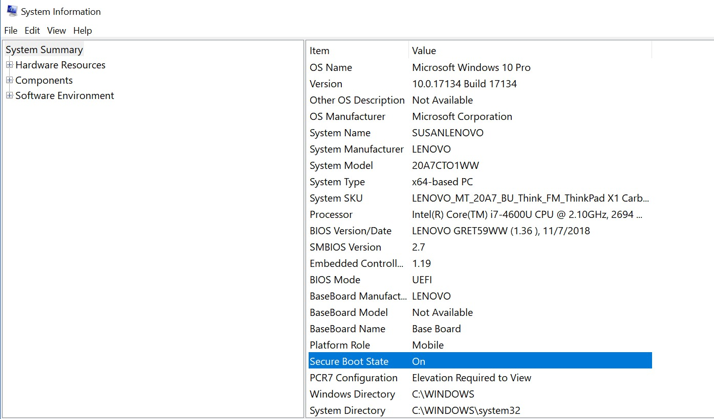
Firmware rootkits require a different approach
To protect yourself from BIOS, UEFI or other firmware rootkits, ensure that your systems’ firmware is up to date. Check to see if your system is using secure boot.

Slide 14

Block Porn on Popular Devices Using DNS https://cleanbrowsing.org/ip-address

Slide 15
Clean Browsing Family Filter IP Addresses
Family Filter
Blocks access to all adult, pornographic and explicit sites. It also blocks proxy and VPN domains that are used to bypass the filters. Mixed content sites (like Reddit) are also blocked. Google, Bing and Youtube are set to the Safe Mode.
IPv4 address: 185.228.168.168 and 185.228.169.168
IPv6 address: 2a0d:2a00:1:: and 2a0d:2a00:2::

Slide 16
Clean Browsing Adult Filter IP Addresses
Adult Filter
Blocks access to all adult, pornographic and explicit sites. It does not block proxy or VPNs, nor mixed-content sites. Sites like Reddit are allowed. Google and Bing are set to the Safe Mode.
IPv4 address: 185.228.168.10 and 185.228.169.11
IPv6 address: 2a0d:2a00:1::1 and 2a0d:2a00:2::1

Slide 17
Clean Browsing Security Filter IP Addresses
Security Filter
Blocks access to phishing, malware and malicious domains. It does not block adult content.
IPv4 address: 185.228.168.9 and 185.228.169.9
IPv6 address: 2a0d:2a00:1::2 and 2a0d:2a00:2::2

Slide 18
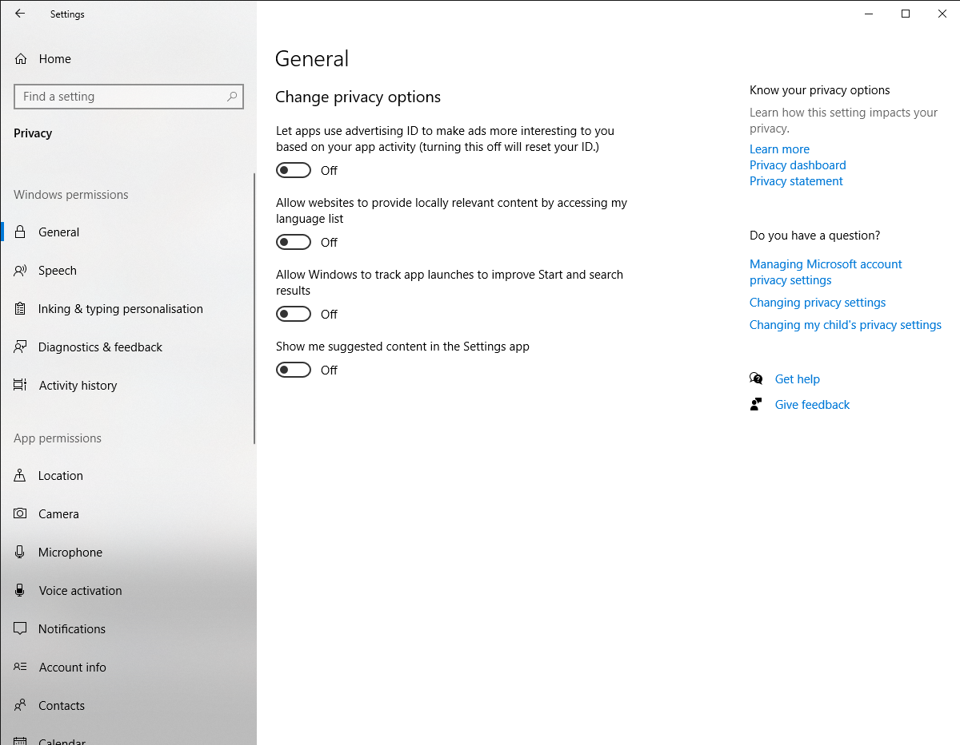
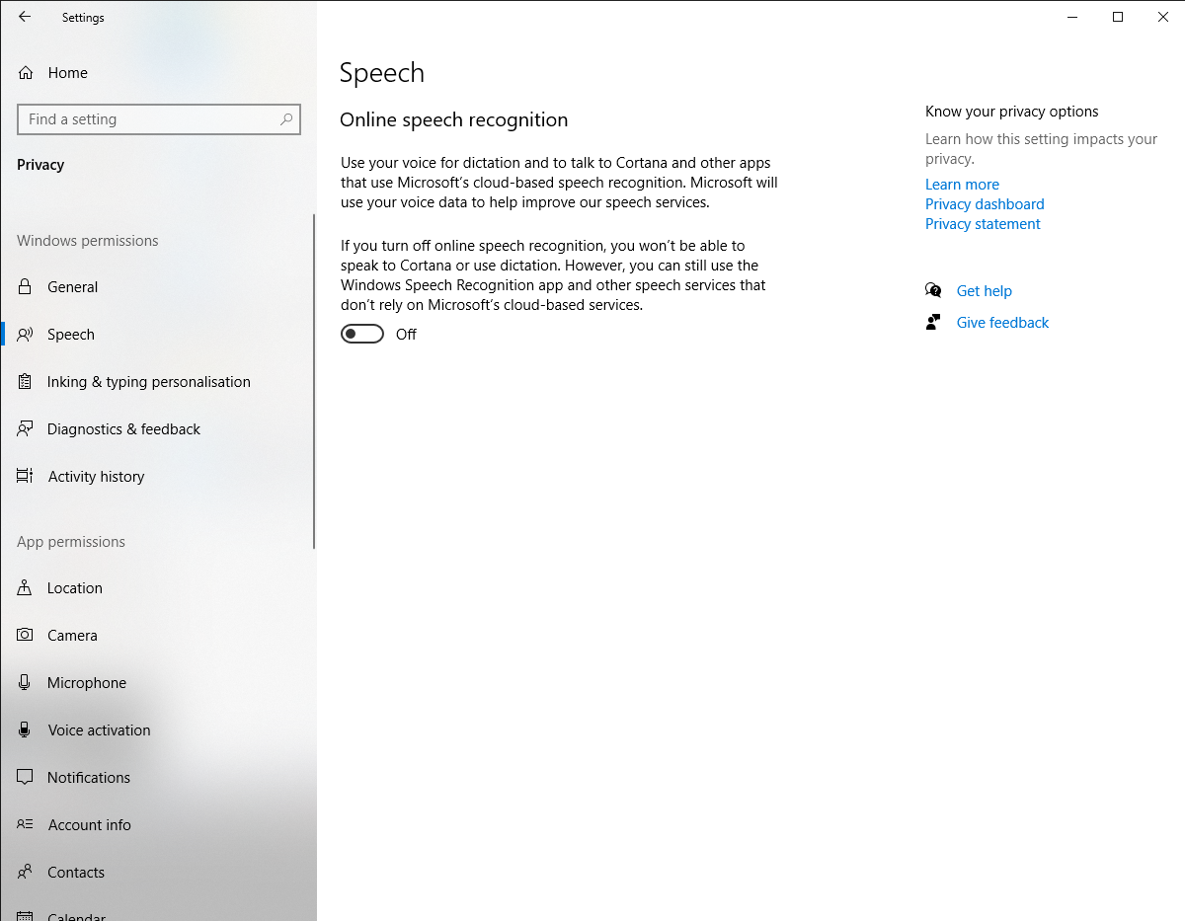
Windows 10 Privacy Settings You Should Check

Slide 19
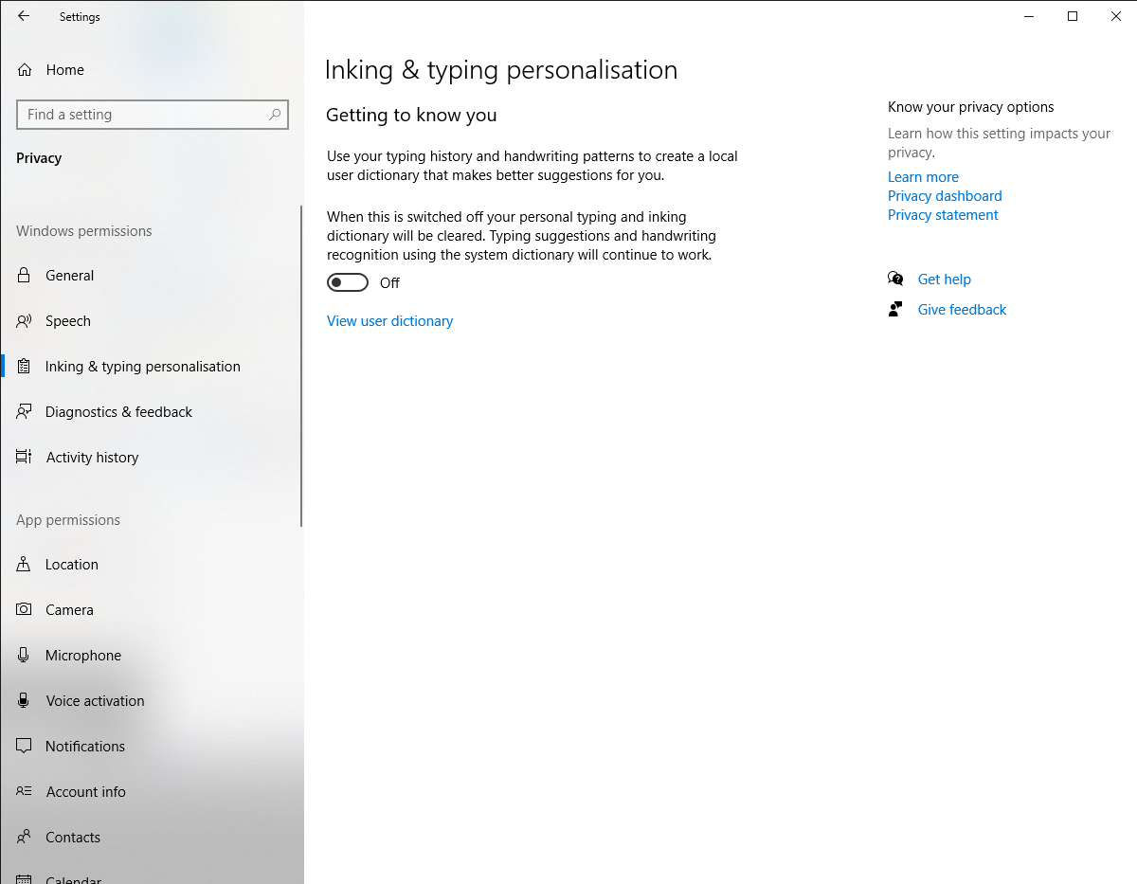
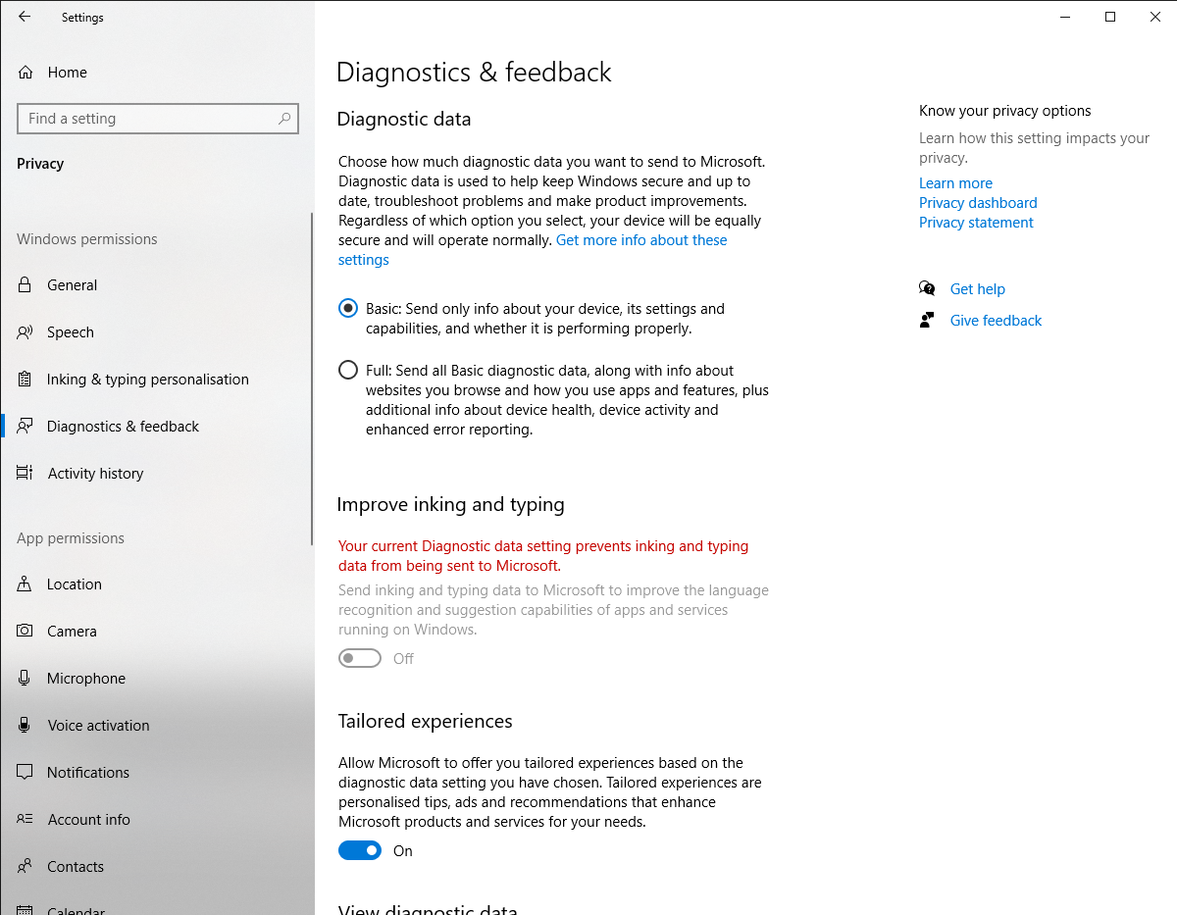
Windows 10 Privacy Settings You Should Check

Slide 20
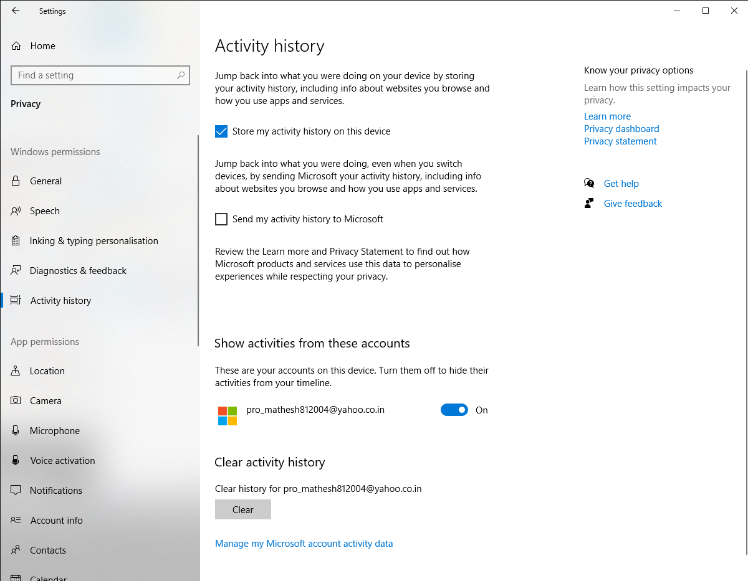
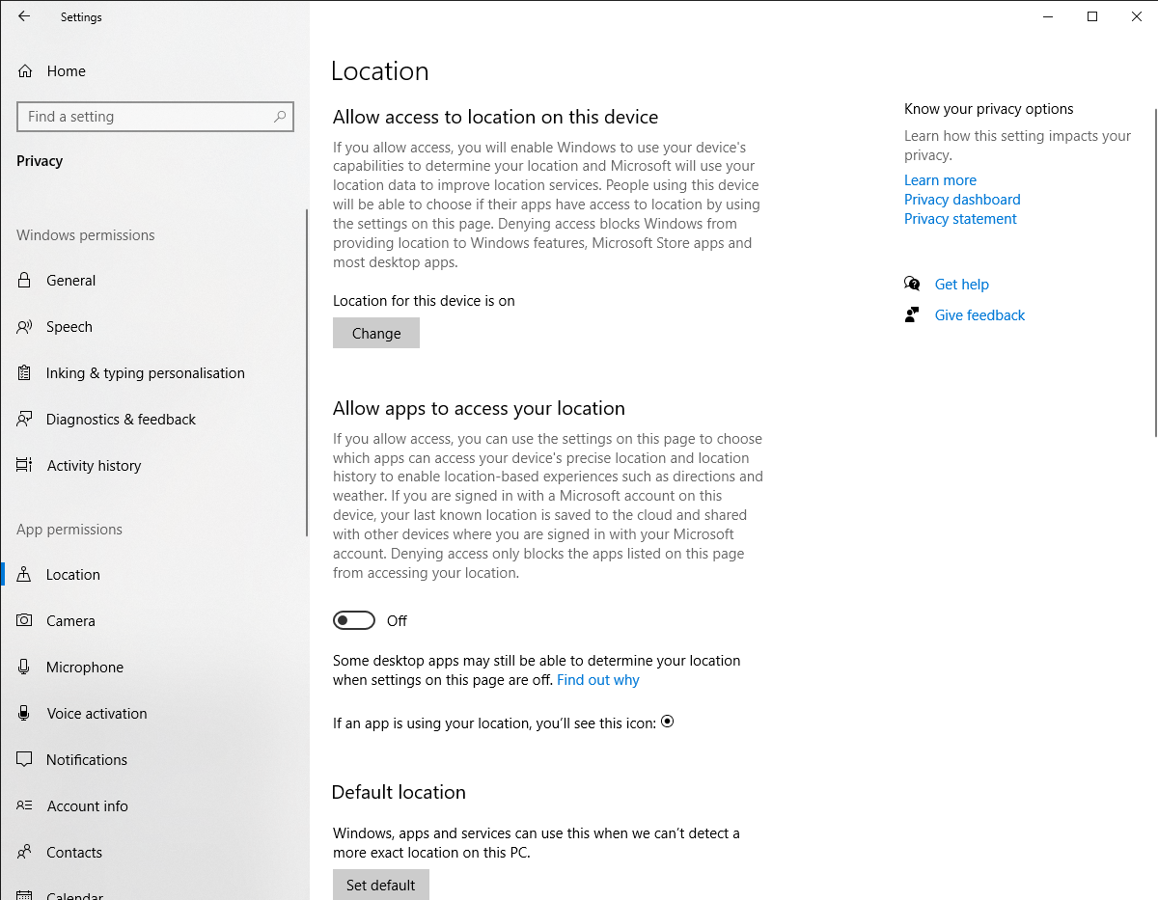
Windows 10 Privacy Settings You Should Check

Slide 21
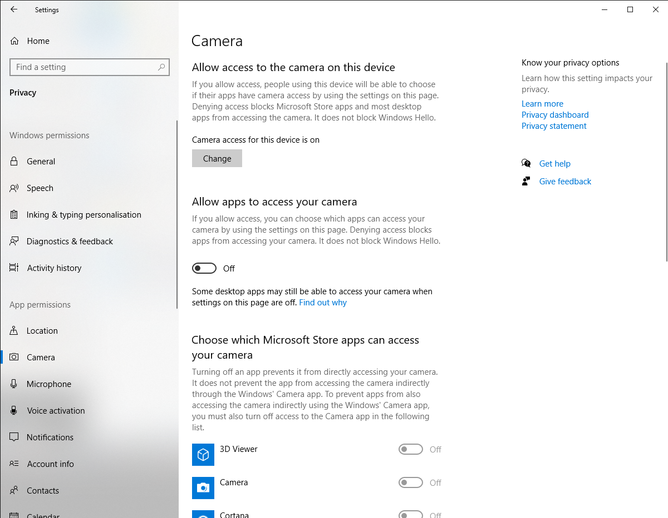
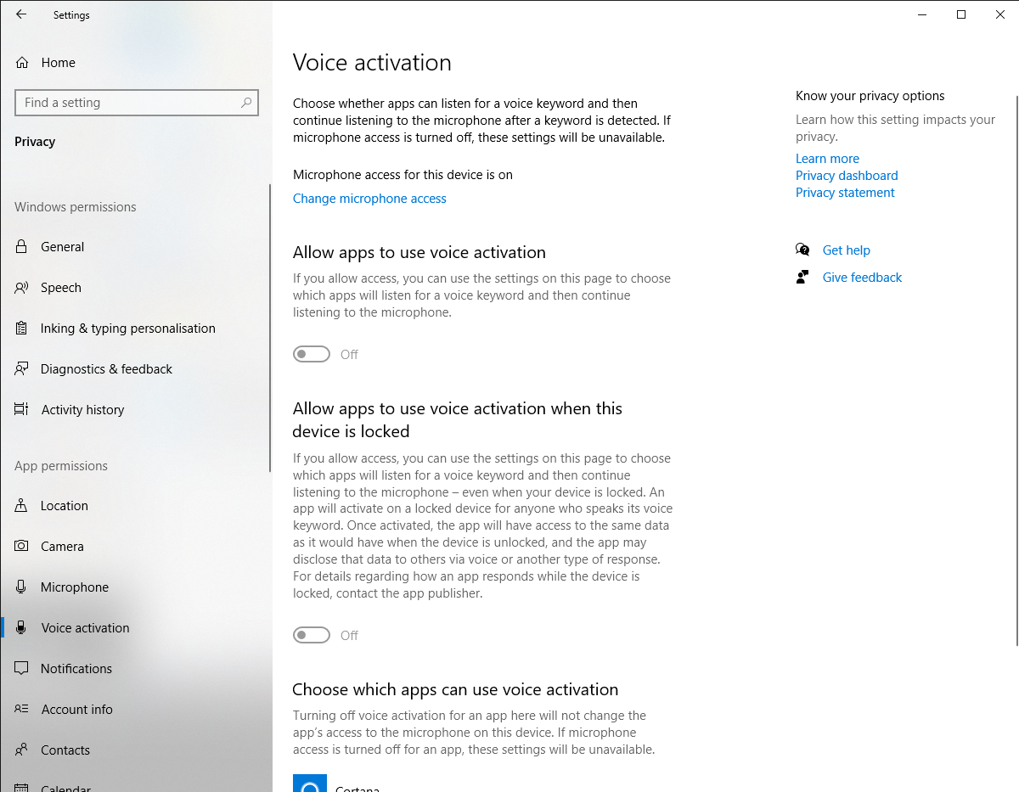
Windows 10 Privacy Settings You Should Check

Slide 22
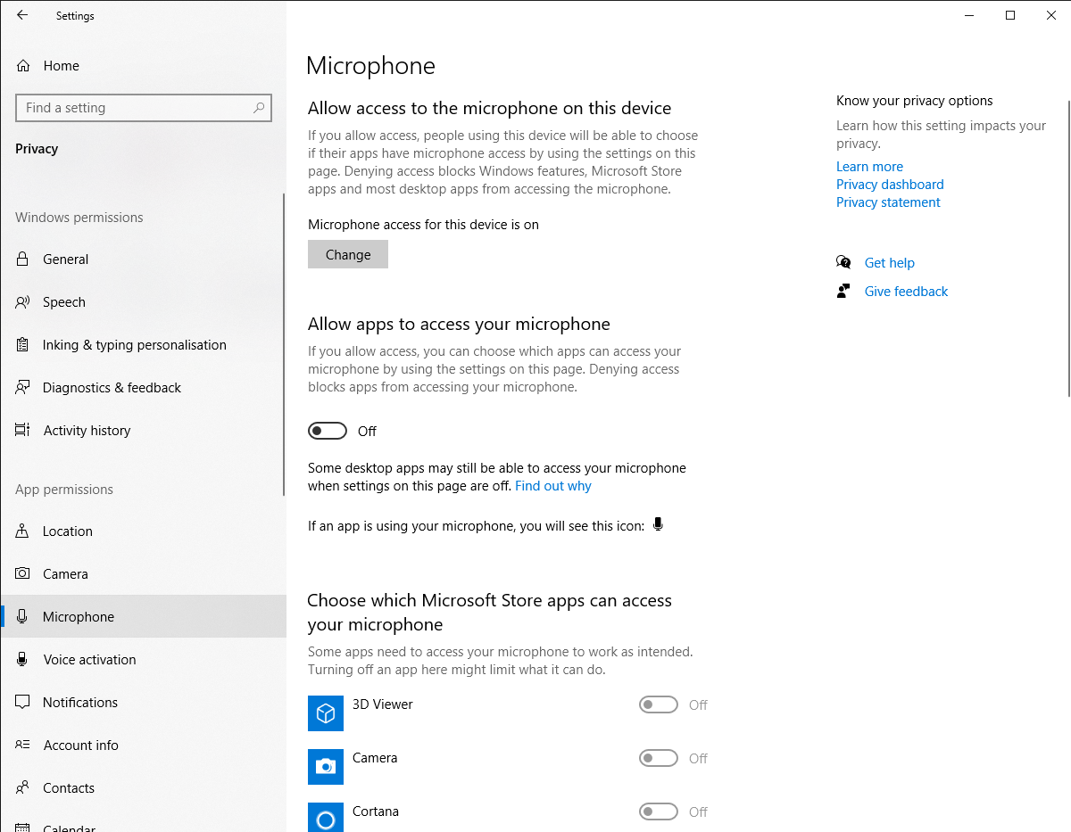
Windows 10 Privacy Settings You Should Check

Slide 23
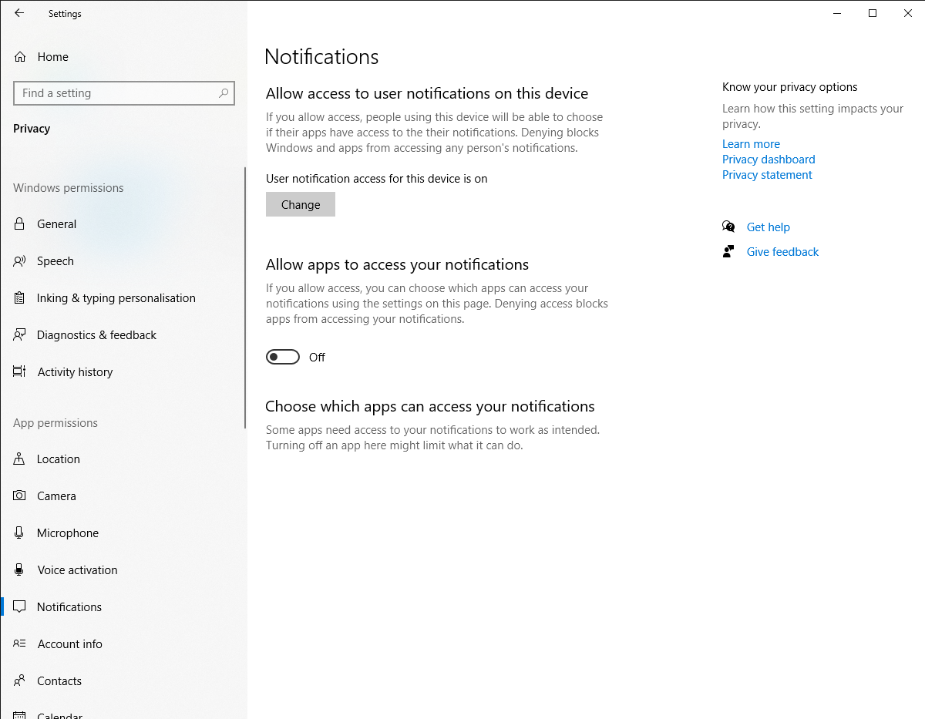
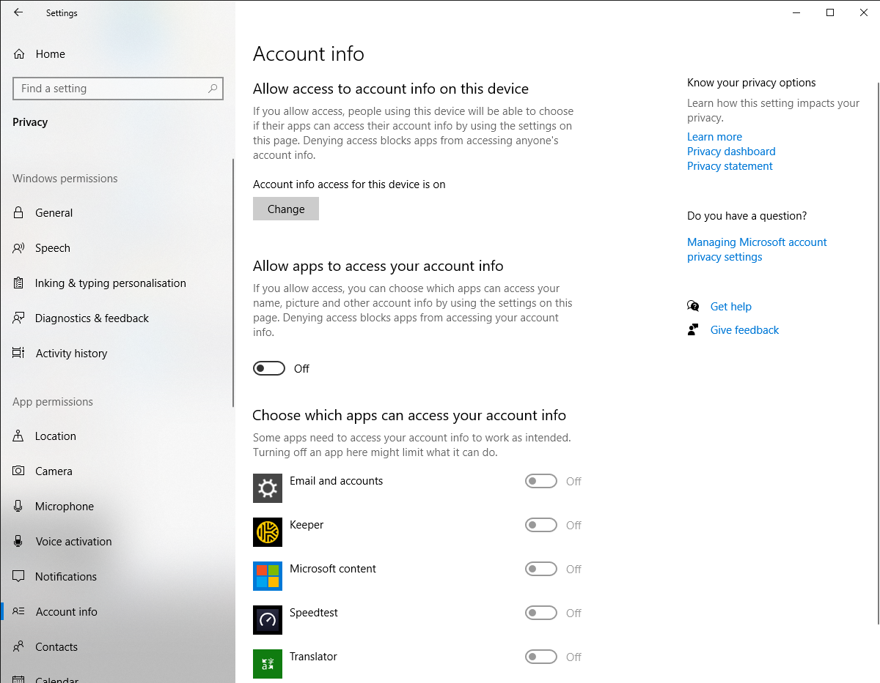
Windows 10 Privacy Settings You Should Check

Slide 24
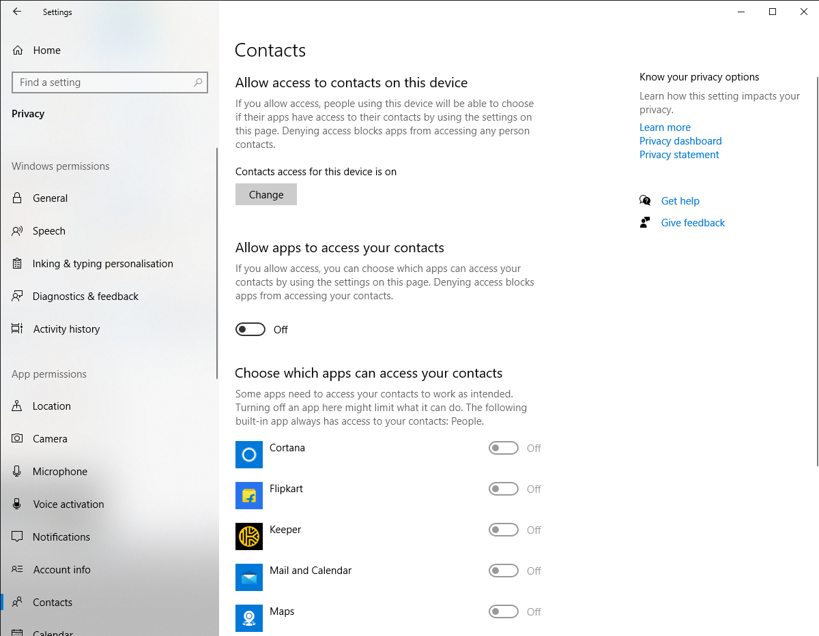
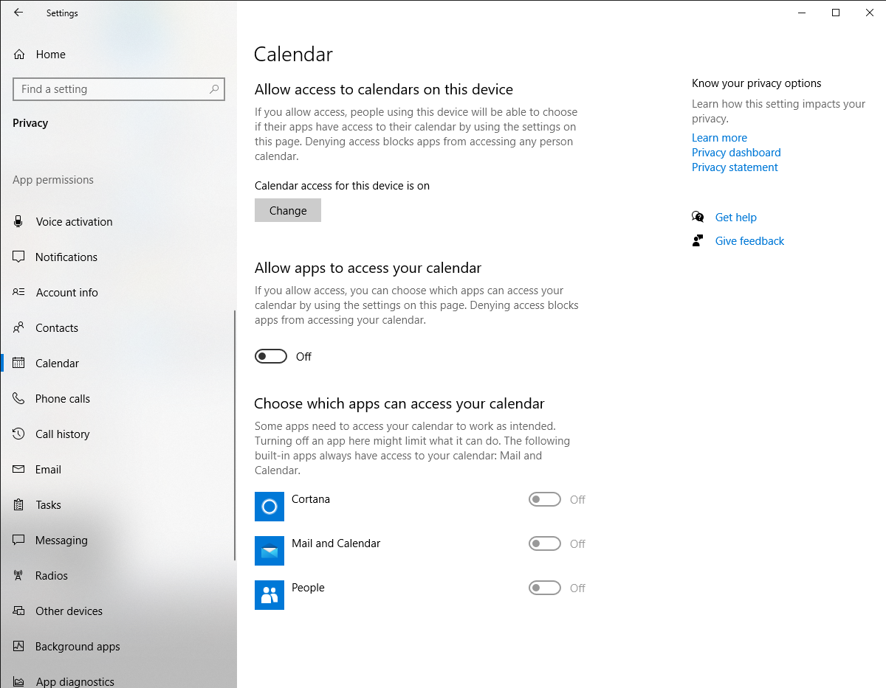
Windows 10 Privacy Settings You Should Check

Slide 25
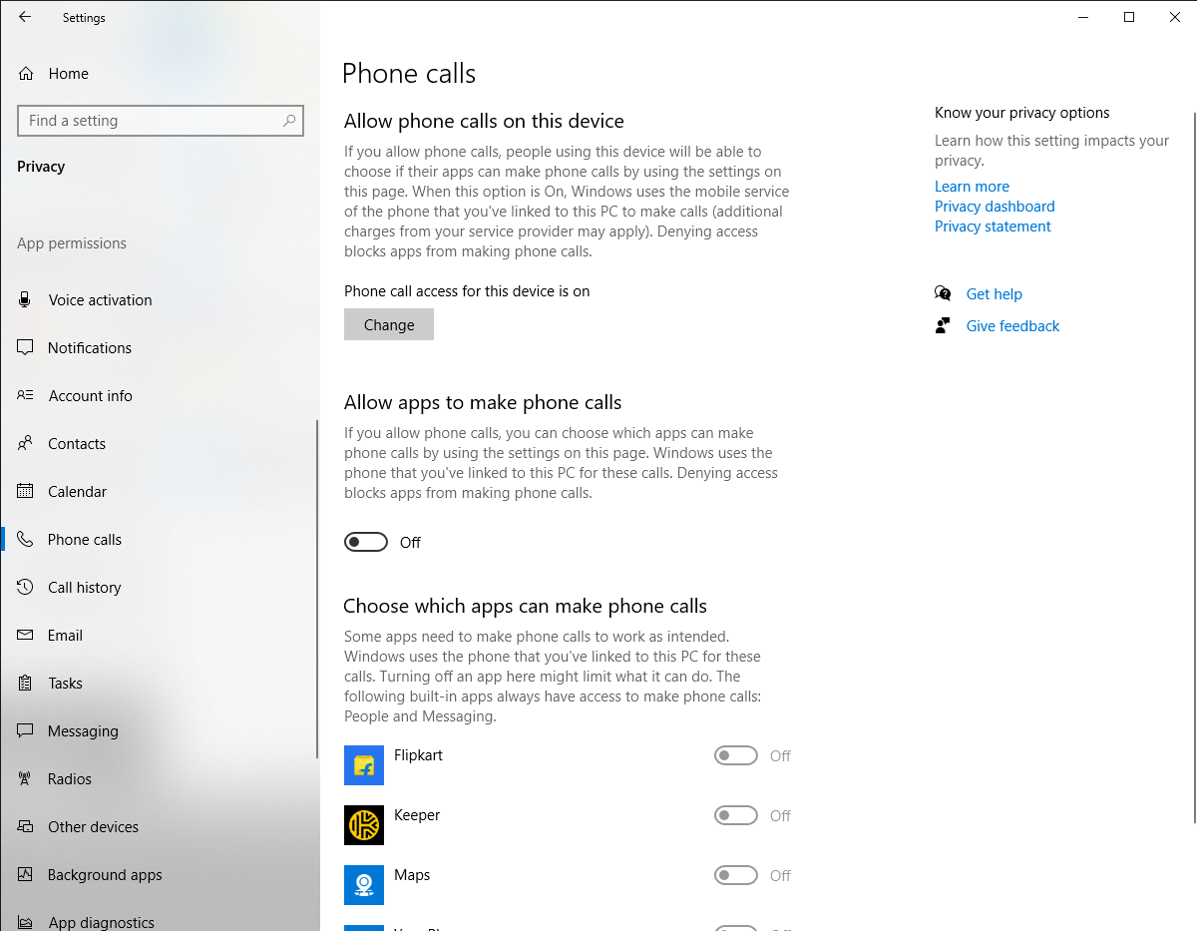
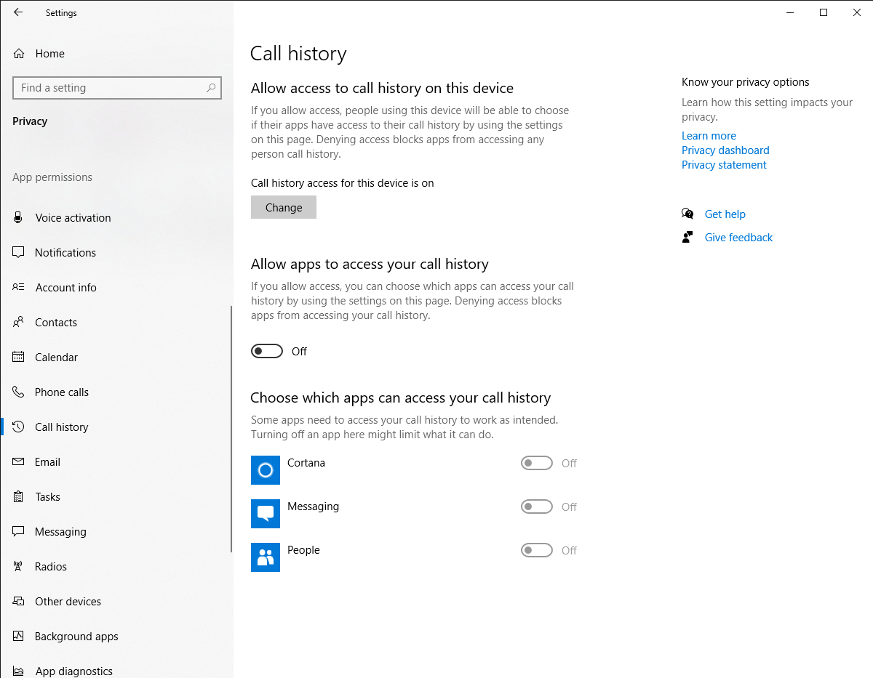
Windows 10 Privacy Settings You Should Check

Slide 26
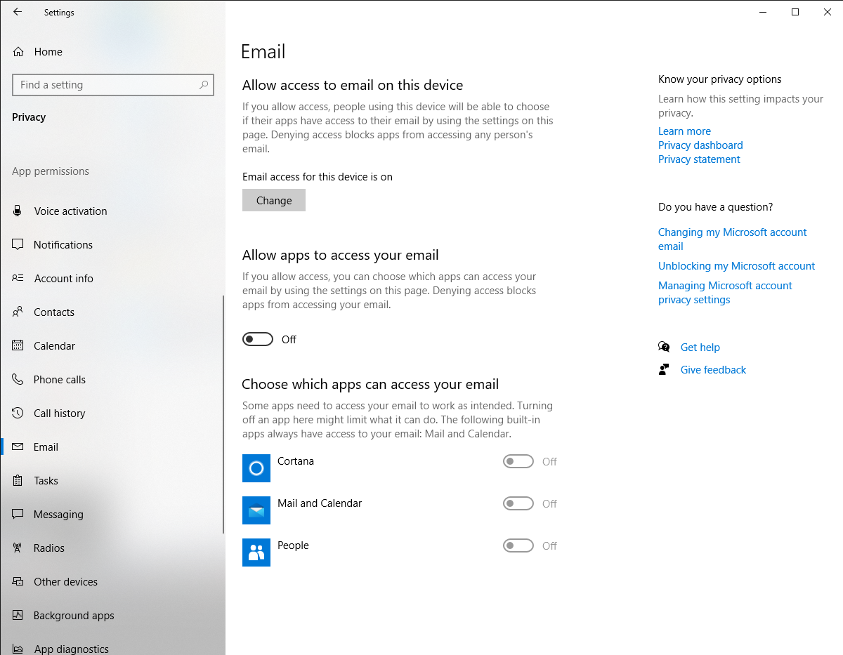
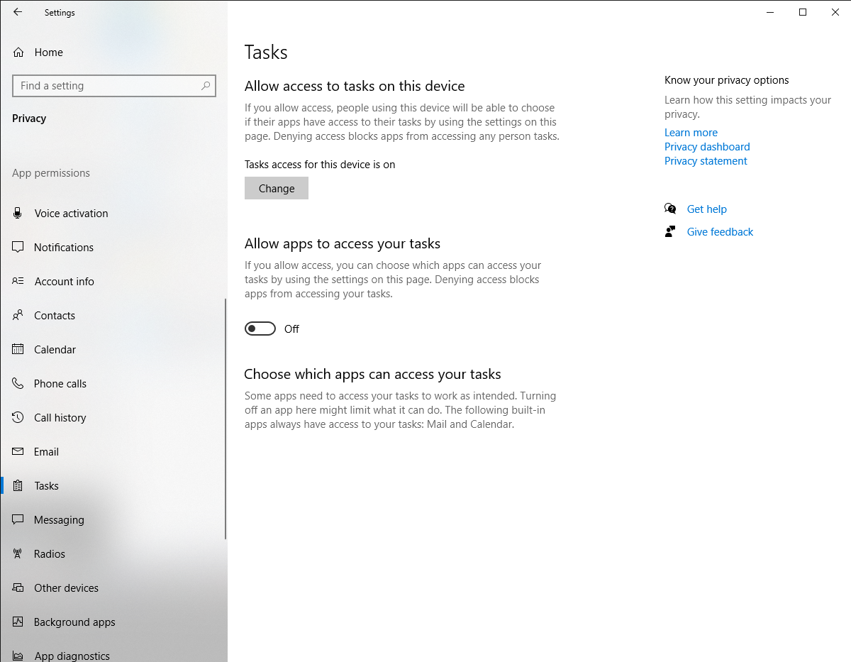
Windows 10 Privacy Settings You Should Check

Slide 27
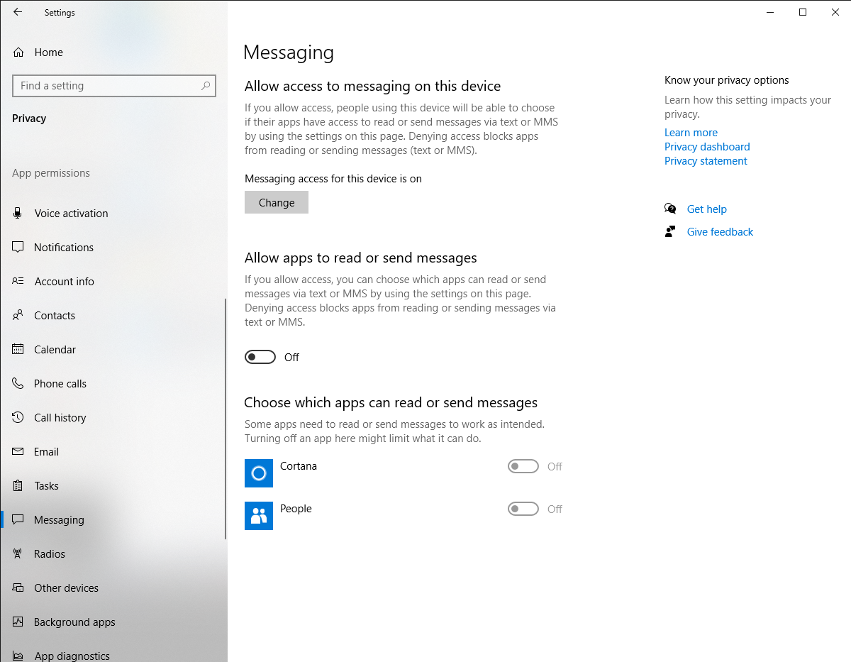
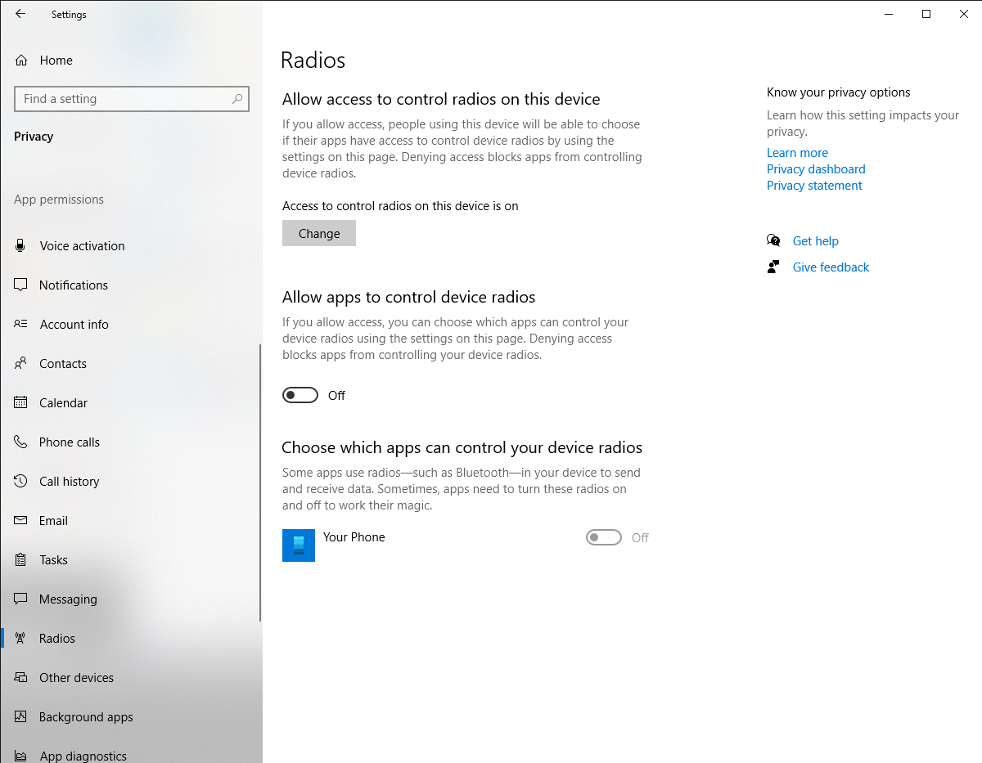
Windows 10 Privacy Settings You Should Check

Slide 28
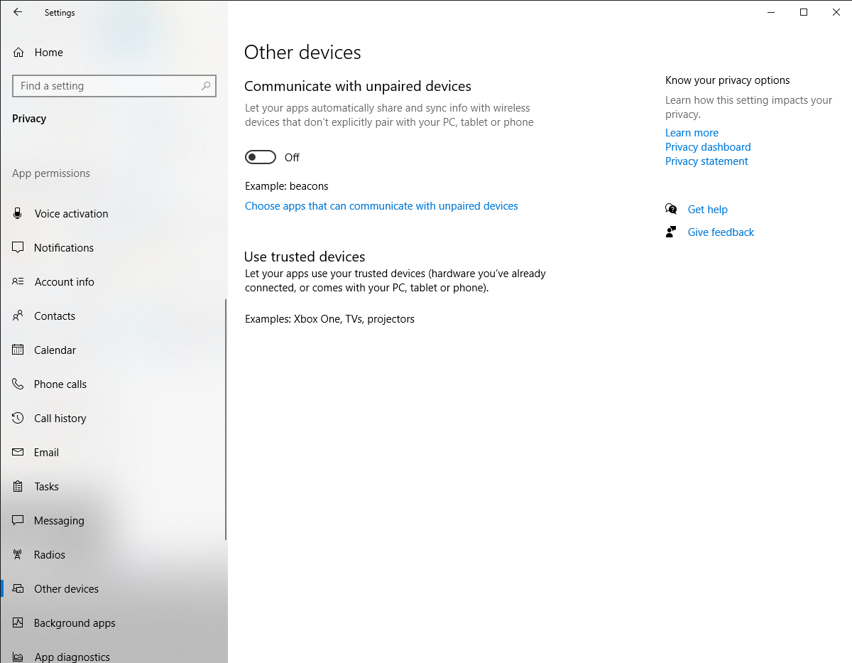
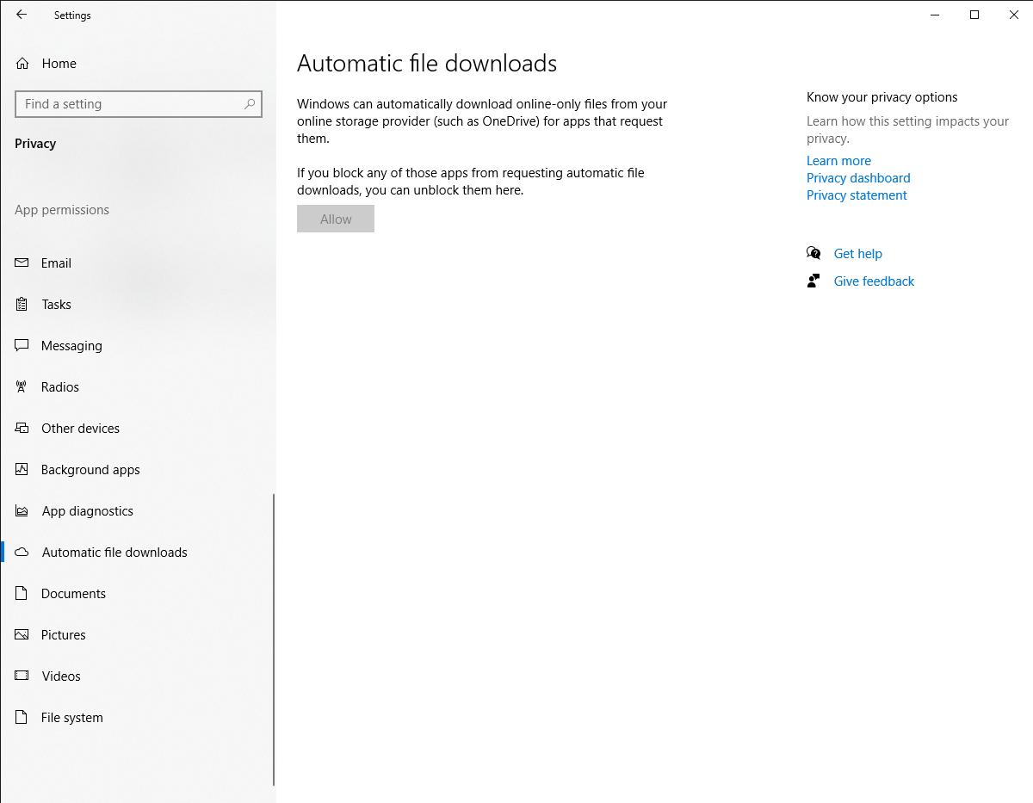
Windows 10 Privacy Settings You Should Check

Slide 29

For more tips and Advisories visit https://cscoe.itewb.gov.in
Thank you

