Slide 1


Cyber Security Centre of Excellence Department of Information Technology & Electronics, Government of West Bengal
https://cscoe.itewb.gov.in

Slide 2
Coping with Cyber Frauds
Shri Kausik Halder, CS-CoE
Shri Palash Kumar Dutta , CS-CoE
Shri Sayantan Shome, CS-CoE

Slide 3

What is Cybercrime?
Any crime that takes place online,
i.e. in Cyberspace

Slide 4
Types of Cyber Threats
Known Threats
Un-Known Threats

Slide 5
Common Cybercrimes
Fraud | Spamming
Hacking | Phishing
Identity Theft | Social Engineering
Scamming | Malvertising
Computer Viruses | Cyberstalking
Ransomware | Piracy
DDoS Attack | Child Pornography
Botnets | Cyberbullying, etc.

Slide 6
Fraud
Cybercrime unlawfully gains important information to deceive a person or an organization
Can be done by
Altering
Destroying
Stealing
Suppressing
any information to secure unlawful or unfair gain

Slide 7
Hacking
Partial / complete acquisition of certain functions within a computer, network, or website.
Motive
Accessing important information
Breaching privacy

Slide 8
Identity Theft
Stealing of
Personal data, including login credentials
Bank account details including credit/debit cards
Social media profile details
Other sensitive information

Slide 9
Scamming
Any illegal plan to make money is scamming.
Can be done by offering
Computer repair
Network troubleshooting
IT support services, etc.
Forcing users to shell out money for cyber problems that do not even exist.

Slide 10
Computer Viruses
Viruses are used to gain unauthorized access to computers/networks and steal important information.
Can spread through
Removable devices like USB, External HDD, etc.
Internet
CD/DVD, etc.

Slide 11
Ransomware
Malware-based attacks which impair your computer and encrypt files.
The attacker then demands ransom to restore access to the files upon payment.

Slide 12
DDoS Attack
Distributed Denial of Service (DDoS) attacks temporarily or completely interrupts servers and networks and make them busy.

Slide 13
Botnets
Botnets are controlled by remote attackers called “bot herders” to attack computers by sending spams or malware.

Slide 14
Spamming
After obtaining the email addresses of a huge number of individuals, spammers send bulk emails to hundreds or thousands of recipients at a time. They are usually commercial in nature and not expressly malicious.

Slide 15
Phishing
Phishers act like a legitimate company or organization.
They use “email spoofing” to extract confidential information.
They send out thousands of phishing emails carrying links to fake websites.
Believing these as legitimate, victims share their personal information.

Slide 16
Social Engineering
Social engineering is a method in which cybercriminals make a direct contact through phone calls, emails, or even in person.
Basically, pretend to be a representative of a legitimate company or organization.
They will befriend you to win your trust until you provide your important personal information.

Slide 17
Malvertising
Malvertising is the method of filling websites with advertisements carrying malicious codes.
Users will click these advertisements, thinking they are legitimate.
Once they click these ads, they will be redirected to fake websites or a file carrying viruses and malware which will be automatically downloaded.

Slide 18
Cyberstalking
Cyberstalking is following a person online anonymously.
The stalker virtually follows the victim, including his or her activities.

Slide 19
Piracy
The internet is filled with torrents and other programs that illegally duplicates original contents, including songs, books, movies, albums, and software.

Slide 20
Child Pornography
Porn content is globally accessible because of the internet.
This cybercrime exploits children in the porn industry.

Slide 21
Cyberbullying
Cyber bullying is the harassment or bullying executed through Internet
Publishing embarrassing photo or video
Posting harmful, nasty or humiliating rumours or comments about an individual
Creating a fake webpage about another individual
Issuing online threats and provocations
Posting hate comments or content
Faking an identity online to ask for or post personal or fake information about someone

Slide 22
How to cope up with the situation?
Stay safe and avoid falling victim to cyber crime
You must have a fully updated operating system
All application software have to be updated regularly
Computer should have updated antivirus protection
Computer should have standard firewall
Safe browsing habits
Use strong passwords
Change password regularly
Get rid of unused programs
Don’t connect to unknown Wi-Fi network

Slide 23
How to cope up? (contd.)
Keeping regular backups of your information – Use external hard disk drive (HDD) or USB
Always use secure websites when you’re doing your online shopping or checking your bank account
Look out for the padlock symbol in the address bar
Never click suspicious links or attachments unless the sender is known and trusted.
Phishing emails sometimes spoof the sender’s identity to trick the user into clicking a link or attachment.

Slide 24
Avoid Using Pirated Software
Proprietary Software | Free and open source Software
Windows/Mac | Linux
Microsoft Offce | LibreOffice/OpenOffice.org
Microsoft Outlook | Mozilla Thunderbird
Internet Explorer | Mozilla Firefox
Windows Media Player | VLC Media Player
Adobe Photoshop | GIMP
Adobe InDesign | Scribus
Adobe Illustrator | Inkscape
AutoCAD | FreeCAD and Archimedes
Microsoft Visio and Smart Draw | SmartDraw

Slide 25
Avoid Using Pirated Software (contd.)
Proprietary Software | Free and open source Software
Adobe Premiere CC or Pro | Handbrake, FFmpegYAG
Apple Logic Pro or FL Studio Producer Edition | Audacity
Google Maps | Open Street Map
Adobe Acrobat | Sumatra PDF
Patches (updates)
To correct bugs (or problems) within the software
To add new compatible hardware support

Slide 26
Regular Monitoring
Assess or evaluate computers, systems, or networks for some weaknesses
Use Parameterized Queries
Use Website Security Tools to self check your websites and portals

Slide 27
Regular Monitoring (contd.)
Software Name | Use For
Nmap | IT infrastructure Audit
Angry IP Scanner | IT infrastructure Audit
Advanced IP Scanner | IT infrastructure Audit
Nessus Essentials | IT infrastructure Audit
Open-AudIT Community | IT infrastructure Audit
Burp Suite Community | Website Security Audit
OWASP Zed Attack Proxy | Website Security Audit
Metasploit Framework | Penetration Testing

Slide 28
Peoples are duped via SMS and calls
Fraudsters are continuing to use the telco platforms to spam millions of telecom users with phishing and other such fraudulent SMSs and calls.
To restrict this up to some extent activate DND service
To add your number in NDNC ('Do Not Call‘) list you need to send an SMS to 1909
Fully Blocked Category : Send an SMS “START 0” to 1909.

Slide 29
DND registry of TRAI
TRAI has also given an option to opt out for promotional sms from particular category; they have divided it into 7 categories.
Banking/Financial Products/ Insurance/Credit cards
Real Estate
Education
Health
Consumer Goods and Automobiles
Entertainment/Broadcasting/Communication/IT
Tourism and Leisure
If you want to stop SMS from only Real Estate then send an SMS as “STOP 2” and send it to 1909.

Slide 30
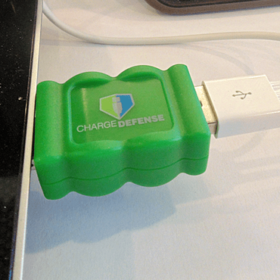
Dangers of using public USB charging stations Juice jacking
Take AC and car chargers for your devices when traveling.
Consider buying a portable charger for emergencies.
Devices:
SyncStop (formerly known as USB Condom)
Juice-Jack Defender

Slide 31
URL Shortener
URL shortening is a technique on the World Wide Web in which a Uniform Resource Locator (URL) may be made substantially shorter and still direct to the required page.

Slide 32
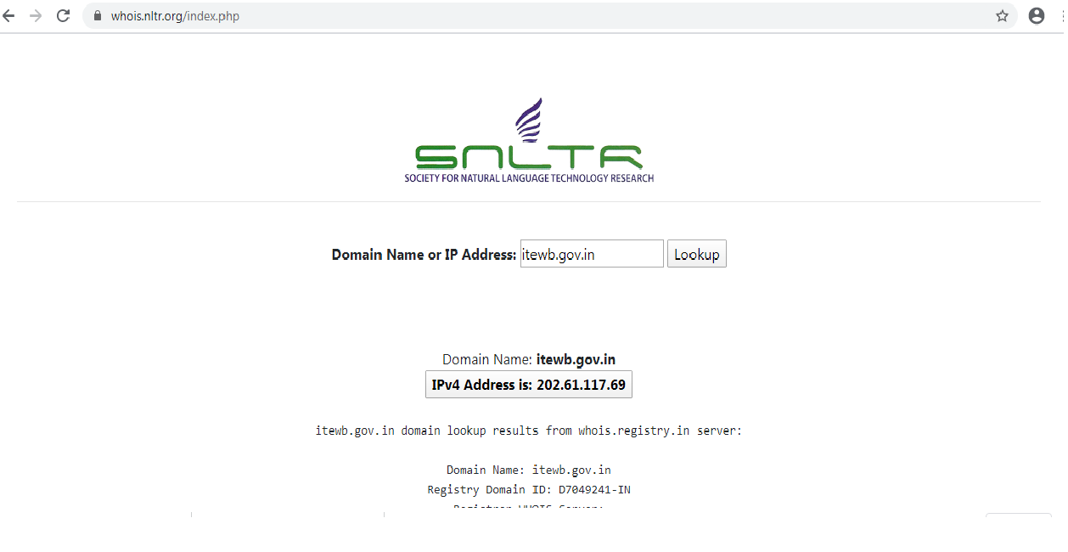
https://whois.nltr.org

Slide 33
Thank You

